Slide 1

Sales Performance Dashboard
Data Analytics Internship Report - Adviyo Technologies
Data Analysis, SQL, Python EDA, Power BI

Slide 2

Project Objectives & Scope
Key Objectives
Project Scope
The core problem addressed by this project was to design a repeatable analytics pipeline converting raw sales records into clear, quantified, and visual business insight.
The dataset mirrors the analytics workflow followed by data teams in the industry, allowing for scalable insights.
Dataset Volume: 150 transaction records
1. Clean and preprocess raw sales data.
Timeframe: Calendar year 2025
2. Extract KPIs using SQL queries.
Categories: Furniture, Office Supplies, Technology
3. Perform Python-based EDA for trends.
Geography: 5 Regions, 15 States across India
4. Build an interactive Power BI Dashboard.

Slide 3

The Analytics Pipeline
Modern data analytics addresses limitations of manual spreadsheet reporting by utilizing a robust, layered approach.
Stage 1 (Data Collection): Sourcing raw transactional data in CSV format.
Data Architecture
Stage 2 (Cleaning): Removing nulls, casting dates, and standardizing via Pandas.
EXTRACT
CLEAN
QUERY
VIZ
Stage 3 (SQL Analysis): Aggregating massive datasets to derive business KPIs.
Automated pipeline converting raw CSV transactions into Power BI insights.
Stage 4 (Python EDA): Visualizing hidden trends like seasonality using Matplotlib.
Stage 5 (BI Dashboard): Interactive reporting via Power BI for stakeholders.

Slide 4

Key Performance Indicators (2025)
Solid Financial Performance
₹59.1L
The analysis revealed a total sales value of ₹59,13,245 with an overall profit of ₹4,86,178, yielding a steady profit margin of 8.22%.
This volume was generated across 150 total orders by 20 unique customers, resulting in an impressively high Average Order Value (AOV) of ₹39,421 per transaction.
TOTAL SALES VALUE

Slide 5
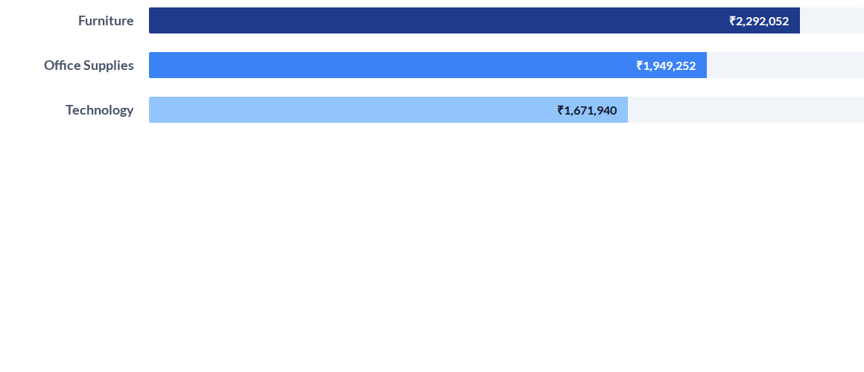
Category-wise Sales Performance
Furniture emerged as the highest-selling category and the top profit contributor (₹2.32L). At the sub-category level, Chairs and Tables generated the highest profit, making them a primary focus for inventory planning.

Slide 6
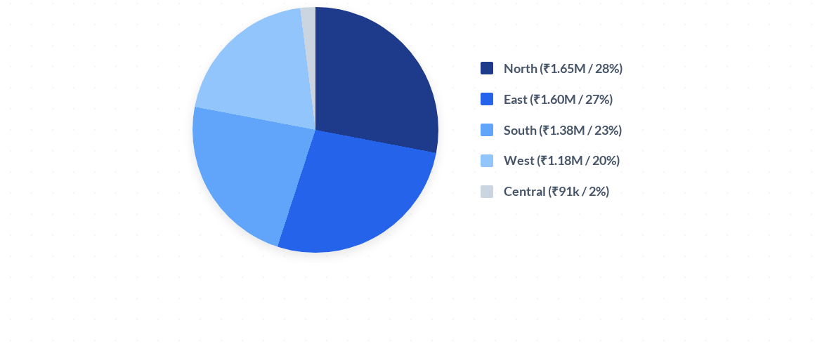
Regional Sales Distribution
The North and East regions are the strongest current markets, collectively accounting for over 55% of total sales. These regions represent ideal targets for focused marketing and expansion campaigns.

Slide 7
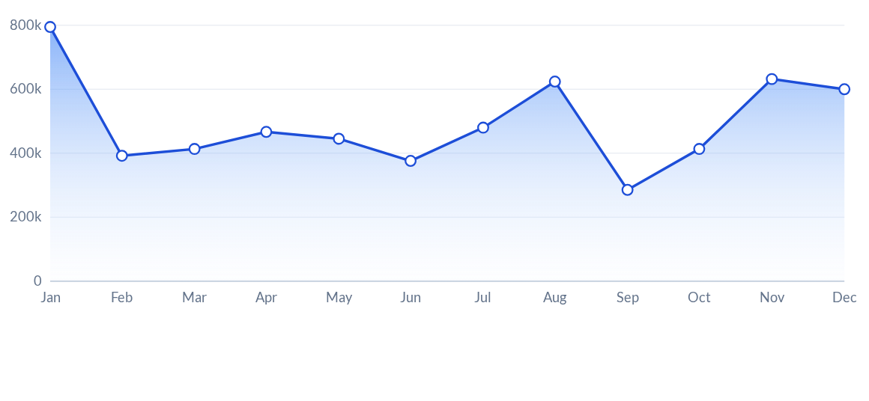
Monthly Sales Trend (2025)
Sales hit peak volumes in January, August, and November, indicating strong seasonal demand linked to year-start purchasing, pre-year-end promotions, and festive seasons.

Slide 8
Top 5 Most Profitable States
Rank | State | Total Profit (₹) | Strategic Assessment
1 | Odisha | 80,674 | Primary growth target; highly lucrative
2 | Maharashtra | 49,389 | Strong commercial hub driving stability
3 | Telangana | 48,676 | Rapidly expanding market presence
4 | Bihar | 43,235 | Emerging market with consistent yields
5 | Delhi | 43,191 | Steady contributor in the North region
Notably, no individual product in the dataset recorded a net loss across all its transactions, indicating that pricing and discounting were well controlled throughout the year.

Slide 9





Key Strategic Insights
High-Value Accounts
Pricing & Discounts
Expansion Priorities
A small group of ten high-value customers contributes a disproportionately large share of revenue, supporting a strong business case for an exclusive key-account loyalty program.
The average discount of 15.4% showed a weak negative correlation (-0.11) with profit. This indicates discounting alone is not eroding profitability and is currently well-managed.
States like Odisha and Maharashtra generate the highest net profits. Meanwhile, states like West Bengal and Tamil Nadu require a comprehensive review of local pricing and cost structures.

Slide 10




Executive Analytics Portal
Future Scope & Next Steps
Scalability & Automation
8.2%
₹59L
The pipeline designed in this internship can be seamlessly scaled to larger, real-time transactional databases using automated ETL (Extract, Transform, Load) scheduling processes.
NET MARGIN
YTD REVENUE
Advanced Capabilities
PREDICTIVE GROWTH MODEL (2026)
Future enhancements include integrating Machine Learning models for predictive sales forecasting, allowing proactive inventory planning.
Additionally, publishing the Power BI dashboard to the cloud service will enable secure, live web-based access for remote stakeholders.

